Slide 1

Smart Resume Screener & Job Recommendation Portal
Capstone Project

Slide 2
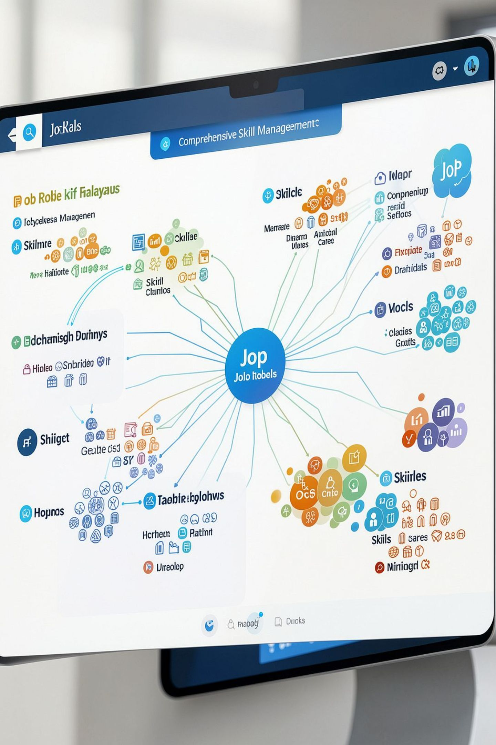
Job Roles & Skill Taxonomy
8 Job Roles Supported:
Skill Categories:
Data Scientist
Web Developer
DevOps Engineer
Android Developer
Data Analyst
ML Engineer
Frontend Developer
Backend Developer
Programming: Python, Java, JavaScript, Kotlin, HTML, CSS
ML/Data: TensorFlow, PyTorch, Pandas, NumPy, Scikit-learn
Cloud: AWS, Docker, Kubernetes, Azure, Terraform
Databases: SQL, MongoDB, PostgreSQL, Redis
Tools: Git, Jenkins, Figma, Tableau, Power BI
Live Job Database:
8 sample job openings
Real salary ranges (7-22 LPA)
Experience requirements (1-6 years)

Slide 3
Requirements & Setup
Python Dependencies:
scikit-learn >= 1.3.0
numpy >= 1.24.0
pandas >= 2.0.0
matplotlib >= 3.7.0
seaborn >= 0.12.0
wordcloud >= 1.9.0
flask >= 3.0.0
gradio >= 4.0.0
nltk
Installation:
pip install -r requirements.txt
Running the Application:
Flask: `python app.py` → http://127.0.0.1:5000
Gradio: `python gradio_demo.py` → Local web interface

Slide 4



Gradio Demo Interface (Ticket 3)
User-Friendly Interface:
Output Display:
Deployment:
Paste resume text in textarea
Instant analysis and results
No technical knowledge required
Predicted job role with confidence percentage
Detected skills list
Top 3 job matches with:
  Job title, company, location, salary
  Fit score percentage
  Matched and missing skills
Shareable web link
Works on any device with browser
Example resume provided for testing

Slide 5







Model Deployment (Ticket 3)
Pipeline Serialization
Save trained model, TF-IDF vectorizer, label encoder
Save job skills taxonomy and job database
Pickle format: resume_pipeline.pkl
Flask Web Application
Role-based access (Candidate/HR views)
Resume upload and text input
Real-time role prediction with confidence scores
Interactive job recommendations
REST API Endpoints
POST /api/predict — JSON resume analysis
GET /api/jobs — Retrieve job database

Slide 6




Fit Score & Job Recommender
Skill Extraction
Extract all detected skills from resume text
Match against comprehensive skill taxonomy (70+ skills)
Fit Score Calculation
Formula: (matched_skills / required_skills) × 100
Ranges from 0% to 100%
Color-coded: Green (≥70%), Yellow (40-69%), Red (<40%)
Job Recommendations
Top 3 matching jobs ranked by fit score
Display matched and missing skills for each job
Include location, salary, experience requirements

Slide 7

Model Training (Ticket 2)
Four Classification Models Trained:
Logistic Regression — max_iter=500, C=1.5
Random Forest — 200 estimators, max_depth=20
Gradient Boosting — 150 estimators, learning_rate=0.1
Linear SVM — C=1.0, max_iter=1000
Evaluation Metrics:
Accuracy, Macro F1, Weighted F1
Precision, Recall per class
Confusion matrices for all models

Slide 8

Feature Extraction (Ticket 2)
TF-IDF Vectorization:
Max features: 5,000
N-gram range: (1, 2) — unigrams and bigrams
Sublinear TF scaling enabled
Minimum document frequency: 2
Train-Test Split:
Training set: 640 resumes (80%)
Test set: 160 resumes (20%)
Stratified split by job role
Output shape: 640 × 5,000 feature matrix

Slide 9

Text Preprocessing (Ticket 1)
Cleaning Pipeline:
01
Remove URLs and special characters
02
Convert to lowercase
03
Remove stopwords
(the, is, in, and, of, to, a, an, for, on, with)
04
Filter words with length > 2 characters
Results:
Average resume length: ~100 words (raw) → ~60 words (cleaned)
Preserves domain-specific terminology
Standardized format for model input

Slide 10

Team 1
Team Lead
Karthika P Mohanan
Team Members
Fathima PM
Fousia TS
Aditya Sasikumar
Fathimath Zuhara PM

Slide 11

Project Overview
An intelligent web application that automatically analyzes uploaded resumes using NLP-driven Machine Learning models and identifies the most suitable job roles for each candidate. The system recommends relevant job openings and highlights key strengths and skill gaps.

Slide 12



Dual-Purpose Platform
For HR Professionals
For Job Seekers
Smarter Hiring
Assists HR professionals by automating the initial screening process
Empowers job seekers with personalized career insights
Makes the hiring process smarter, faster, and more effective

Slide 13


Performance Objectives
Resume Analysis
Extract and process resume content to identify skills and experience
Resume Analysis
Job Recommendation
Job Role Prediction
Extract skills and experience
Suggest best-matching openings
Use NLP models to predict suitable roles with fit-score evaluation
Job Recommendation
Skill Gap Insights
Suggest best-matching job openings based on skill match
Role Prediction
Use NLP to generate fit-score
Highlight missing skills
Skill Gap Insights
Highlight missing or weak skills for improvement

Slide 14

Technical Implementation
Web App Development
Database Integration
Flask-based application with role-based access (Candidate/HR)
Resume upload system and dashboards for ranked candidates
Impact
Streamline hiring and reduce manual screening time

Slide 15

Team Guidelines
Active Participation
All team members must participate actively in project responsibilities
Scrum Methodology
Project tracked using Scrum methodology with scheduled team meetings
Certification Impact
Non-participation may impact internship certification
Repository Updates
Updates must be pushed to project repositories by team members

Slide 16
Data & EDA (Ticket 1)
Dataset Generation:
Exploratory Analysis:
800 synthetic resumes (100 per job role)
8 job roles: Data Scientist, Web Developer, DevOps Engineer, Android Developer, Data Analyst, ML Engineer, Frontend Developer, Backend Developer
Features: Education, experience level, skills, certifications, projects
Resume count distribution by role
Word count analysis (box plots)
Top 15 skills frequency in job database
Word clouds per job role showing skill patterns

